Slide 1

ANZ Transactions

Slide 2
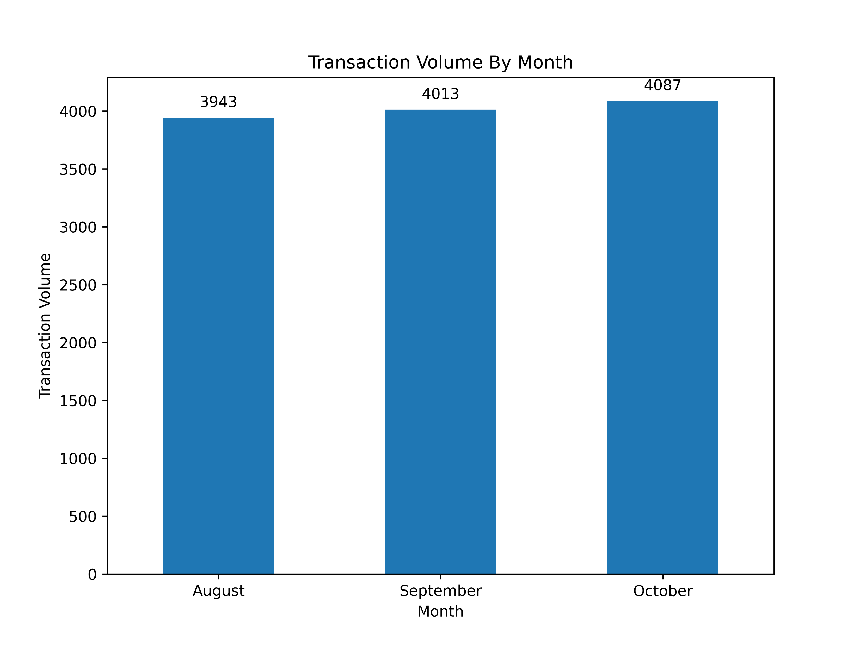
Average Transactions
Average transaction amount: $187.93
Average monthly transaction volume: ~4000

Slide 3
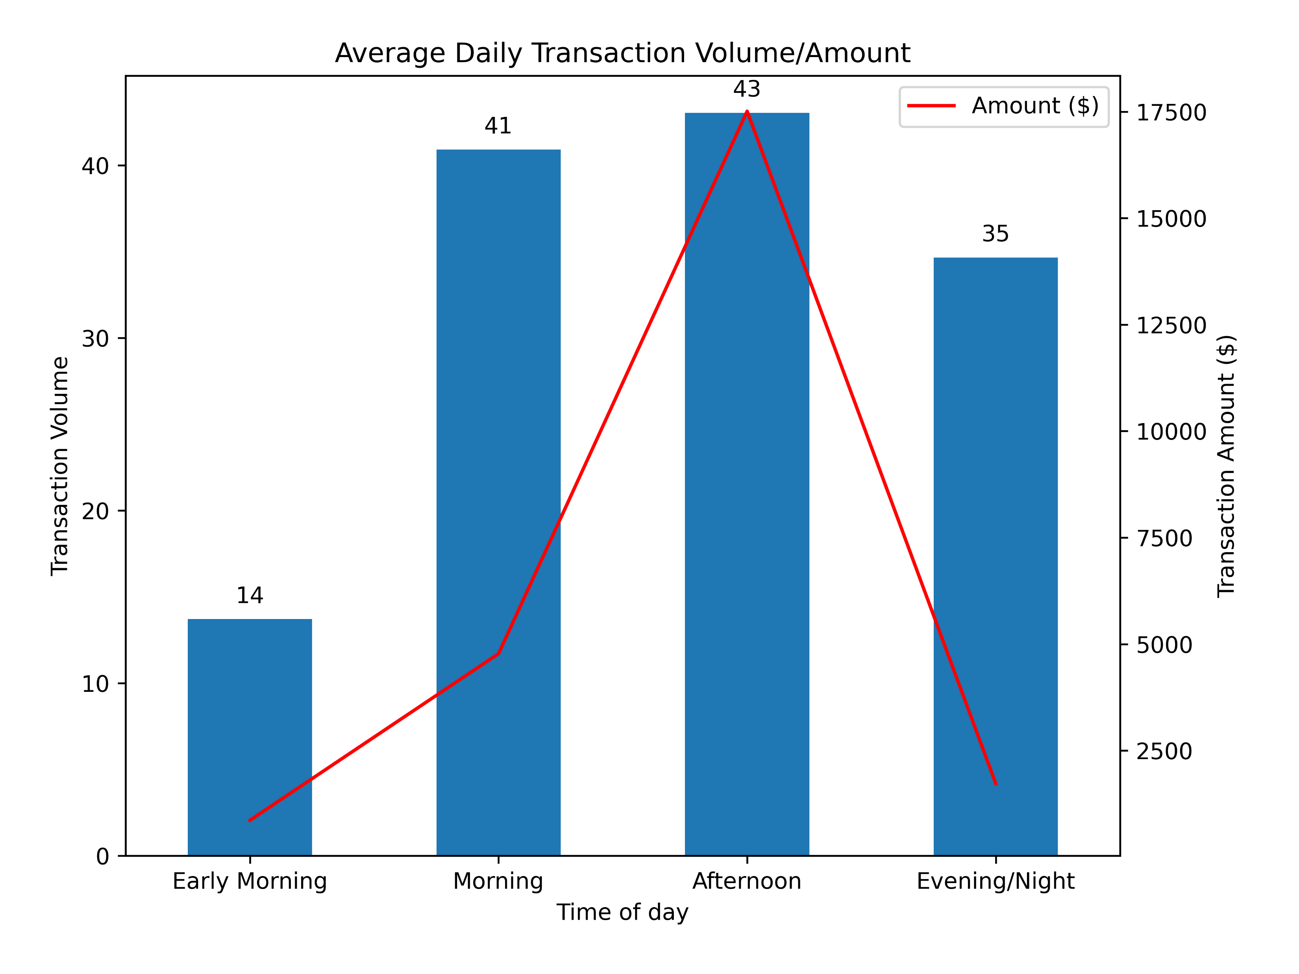
Average Daily Transactions
Transaction volume greatest during morning and afternoon
Transaction amounts significantly higher during the afternoon than other times of the day

Slide 4
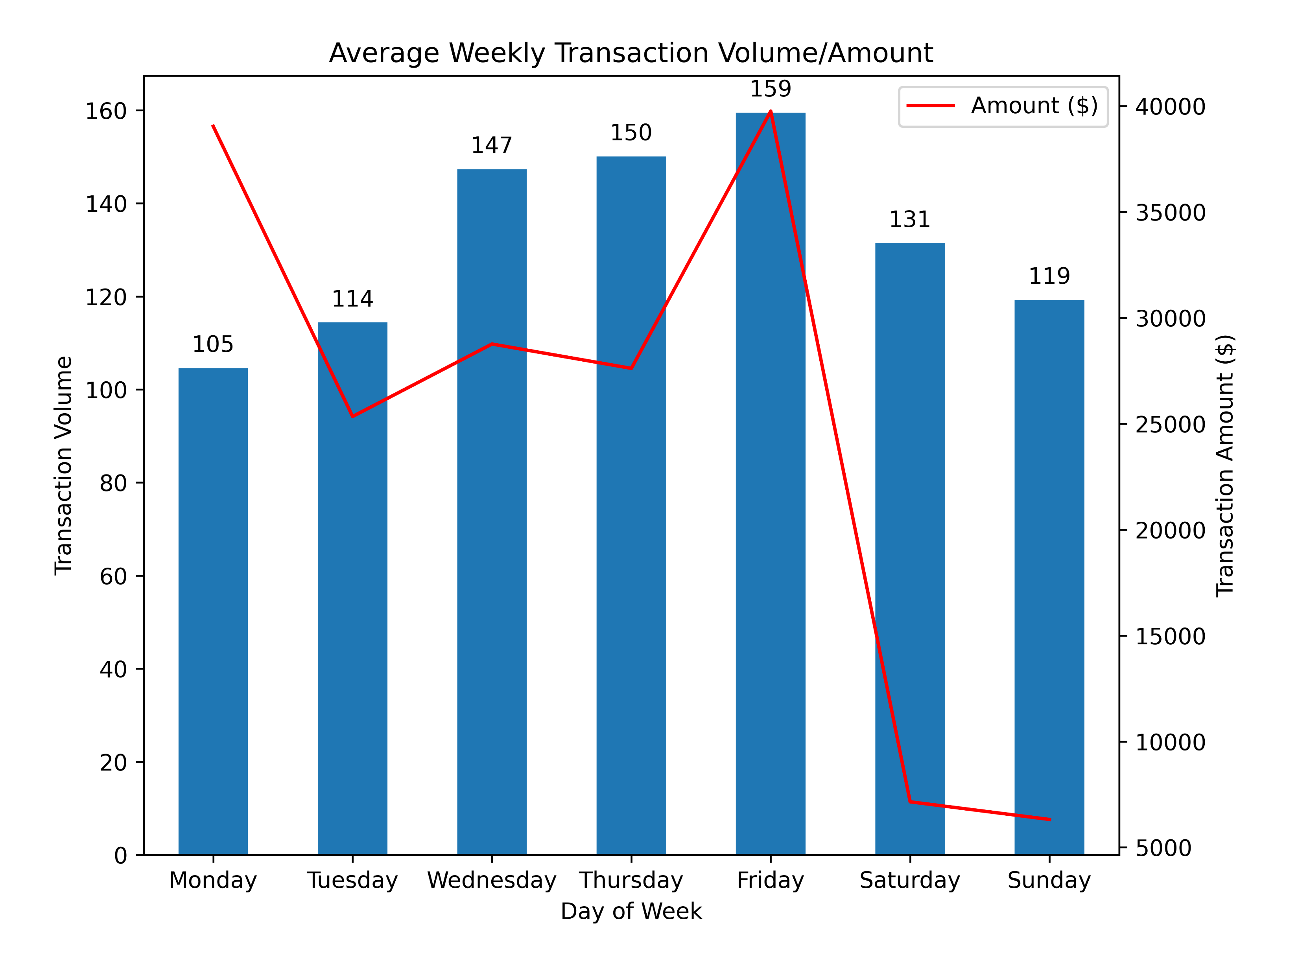
Average Weekly Transactions
Average transaction volumes peak on Fridays
Average transaction amounts highest during Mondays and Fridays
Transaction volumes are considerably high on weekends but low in transaction amounts

Slide 5
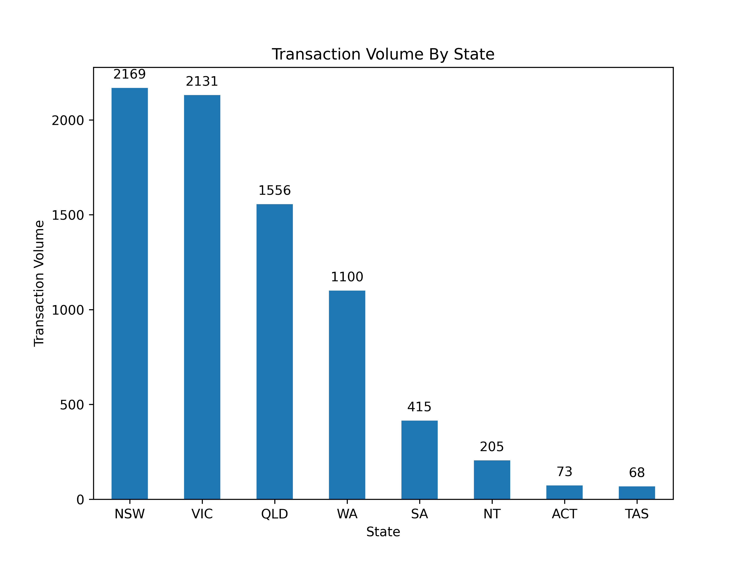
Transactions by State
NSW and VIC have the highest transaction volumes

Slide 6
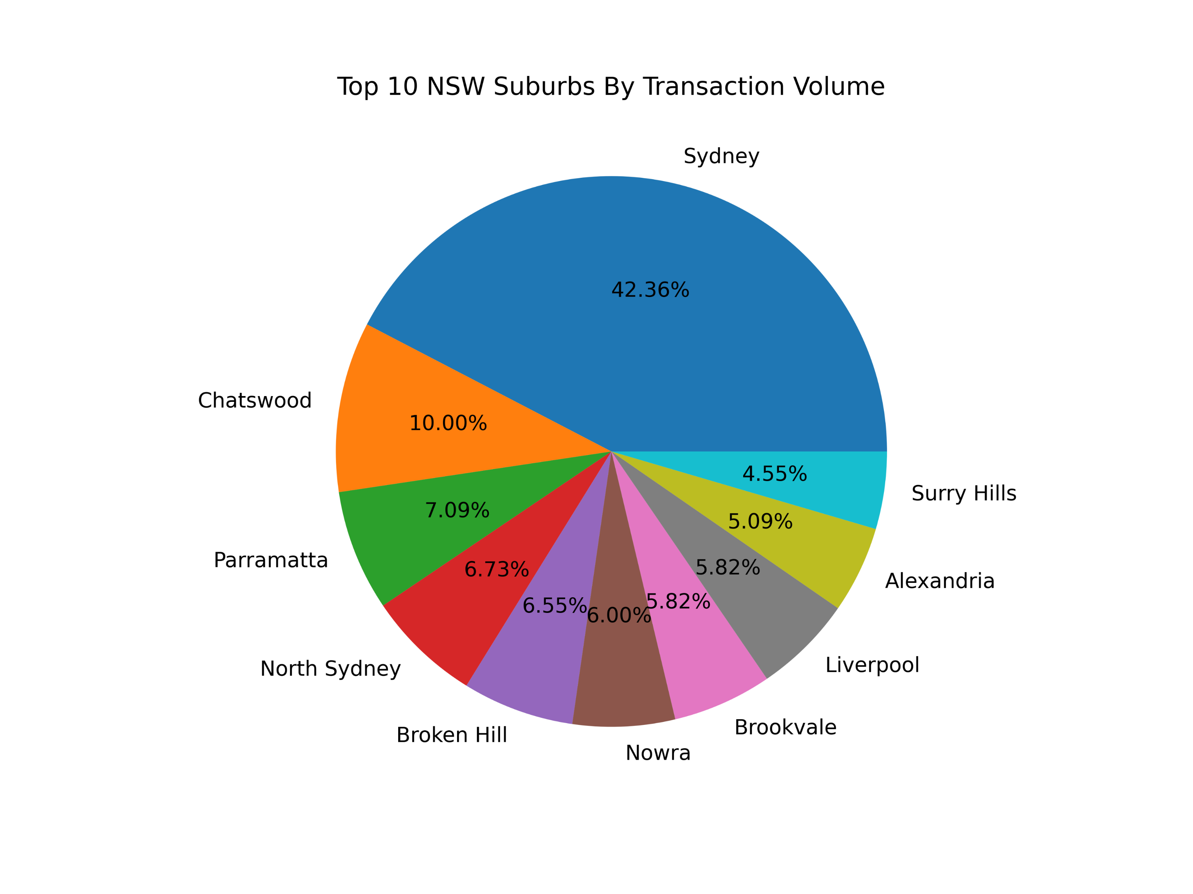
Transactions by NSW Suburbs
Transaction volumes are concentrated in the urban suburbs, esp. Sydney CBD

